Slide 1
When Open Isn’t Really Open: Using Free Software & Open Educational Resources to Realize the Dream
Drs. Jonathan Westfall & Andrea Kunze

Slide 2
Imagine…
You’ve just started your first teaching position after completing your doctorate at a large research institution. You arrive at your new institution to find…
They don’t have a subject pool management system (e.g., Sona), nor the budget for it.
They don’t have an LMS (or a very good one), nor the budget for it.
They don’t have a Qualtrics or SurveyMonkey license, nor the budget for it.
They don’t have a computing cluster running SAS, or a campus license for SPSS, nor the budget for it.
But don’t worry… they still expect you to engage in scholarship (ideally involving your students) for Tenure & Promotion. Your research budget? Maybe $200 a year if you can make a good case for it.

Slide 3
Further…
Your students don’t buy the textbook - it’s too expensive.
You like the resources textbook publishers provide, but you wonder if they’re available elsewhere.
Your IT department is small, but tries to be helpful.
You’re moderately tech-savvy, but have no idea where to start.
You also don’t have a ton of time, since you’re a first year professor.

Slide 4
Free Open Source Software for Instructional Learning (FOSSIL) Project

Slide 5
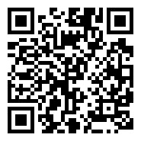
https://go.jonwestfall.com/fossil
FOSSIL…
Provide Knowledge
Provide Resources
Provide Community
What are OERs? Where do I find them? How do I create them?
Content packages, virtual machines, demos
A community to discuss and collaborate!
This talk and upcoming paper
Github Repository
Discord (Chat) Server.

Slide 6
Provide Knowledge
What are OERs? Where do I find them? How do I create them?

Slide 7




What are Open Educational Resources (OERs)?
Openly available content or tool (can be readily found or discovered)
Openly accessible (in a form which others can take it away)
Openly reusable (the user can easily modify it based on creator license permissions)

Slide 8
What Does “Open” Mean? It's a Spectrum.
Social
Openness
Legal
Technical
Financial

Slide 9
Social Openness
The degree to which pedagogy is didactic or participative, through the use of using, contributing, or sharing.
More Didactic
More Participative
Most Participative
Lecture-Centered
Student-Centered
Community-Centered
Traditional & Sharing
Collaborating, Organizing, & Managing
Participating & Contributing
Sharing & Collaborating

Slide 10
Technical Openness
The degree to which software / platforms on which OER are based are themselves open- or closed-source.
Most Restrictive
More Accommodating
Most Accommodating
Proprietary
Proprietary / Open
Open
used, produced, or marketed under exclusive legal right of the inventor or maker.
parts are open-source and free to use, while other parts are proprietary and require a license or payment to access.
openness, transparency, and accessibility of the underlying source code, allowing users to view, modify, and distribute

Slide 11
Financial Openness
Measures the charge for the education provided, ranging from full commercial pricing, including several options for low-cost pricing & ending with gratis pricing.
Least Affordable
More Affordable
Most Affordable
Charged
Low cost
Opportunity Cost
Free
Market-Based Pricing
Small Charge & Subscription Fee
Contribution in Kind & User Registration
No Cost (Gratis)

Slide 12
Legal Openness
Degree to which licence grants users rights over the material, ranging from copyrighted (no rights to user), including the full spectrum of creative commons licenses, up to no rights reserved (all rights to user).
Most Restrictive
More Accommodating
Most Accommodating
Copyright
Limited Public
Public Domain
Attribution noncommercial no derivatives
Attribution noncommercial share alike
Attribution no derivatives
Attribution Share alike
Attribution
All rights reserved
No rights reserved

Slide 13
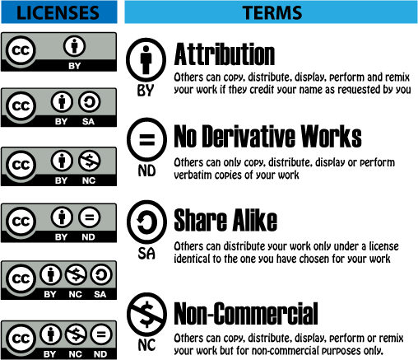
Types of License (Creative Commons)

Slide 14
From OERs to OEPs (Open Educational Practices)
Recognize OERs contribute to the value of an educational institution.
Use and build on prior OERs as part of a participative practice in the classroom
Go beyond access and seek ways to use OERs for transformative learning.
Focus on learning as a construction of knowledge assets which we can share with others and receive feedback and reviews.
Improve quality through external validation because of the importance of sharing of resources.
Change your educational paradigm → knowledge is co-created and facilitated through mutual reflection.

Slide 15
How Are OERs Being Used in Psychology?
Limited in their social and technical "openness" i.e., mostly textbook and lecture slides with multiple-choice test banks hosted on paid sites
Courses | Count | (%)
Statistics | 1 | 4%
Social | 2 | 7%
Biological | 2 | 7%
Personality | 1 | 4%
Language | 1 | 4%
General | 13 | 46%
Developmental | 2 | 7%
Community | 2 | 7%
Abnormal | 1 | 4%
Communication | 3 | 11%
Country of Creation | Count | (%)
USA | 11 | 39%
Canada | 16 | 57%
Australia | 1 | 4%
Paid Hosting | Cost | Purpose
Pressbooks | 400/yr | Host interactive text
Lumen Learning | $25 per student | Interactive courseware
Cerego | $10/per student | AI and adaptive learning creation tool

Slide 16
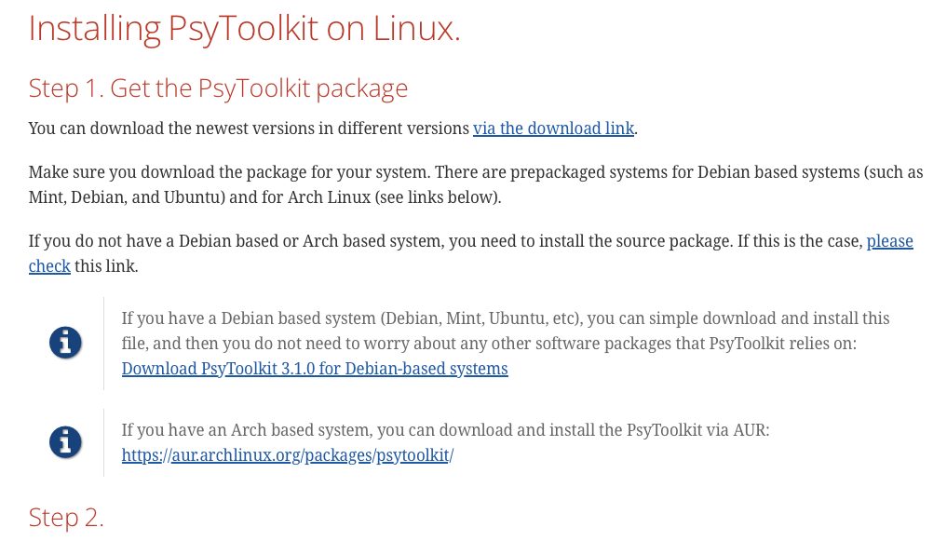

Of course there are potential bad actors…
Be Weary: Publishers can utilize OER the same way we do, but they also can lock it behind a “walled garden” and claim it as a value add.
Ask publishers how the materials on their platforms are written, by whom, and if those people were paid.
Be Weary: Things can change.
Look at a platform’s data retention policy, license model, and ability to export your content out.
Some of the worst offenders: Pressbooks, SurveyMonkey, & PsyToolkit

Slide 17
Why Use & Contribute to OERs?
Increase Equity – all students and educators can have free materials
Keep Content Relevant and High Quality – OERs tend to be more up to date with opportunity of multiple authors adapting & updating (more eyes, the better!)
Empower Educators – beg, borrow, steal (a.k.a. create, customize, adapt) to fit your instruction & students
Reallocate Money – funding for books, tests, simulations, activities, etc. can be reallocated to more transformative or meaningful experiences in or outside the classroom (e.g., add lab fees to do things)

Slide 18
Shouldn’t I worry about ‘giving away’ my intellectual property?
“Why should I give away my materials and work I put time and intellect into?”
“What if someone takes advantage of it by selling it or exploiting my work?”
“Why would I want students and other faculty judging my work?”
“I do not have the time or money to contribute to OERs”

Slide 19
No, You Shouldn’t Worry.
“Why should I give away my materials and work I put time and intellect into?”
You already do! Publishers & journals make billions a year off of your unpaid intellectual property and then they further gatekeep it!
“What if someone takes advantage of it by selling it or exploiting my work?”
There are benefits / incentives to sharing work (e.g., opportunity for future collaborators)
“Why would I want students and other faculty judging my work?”
They already are, but now you have the opportunity to co-create to improve your teaching quality
“I do not have the time or money to contribute to OERs”
Some institutions require an institutional push / incentive to allow faculty room & support to do this (ask yourself, does this qualify as being collegial or open room for collaborations?)

Slide 20
Development & Implementation Process for OERs
Discovery
Evaluation
Obtain
Selection
Finding / identifying published resources
Check quality & fit of resources for desired purpose
Download or Stream Material
Creation
Description
Approval
Publication
Author or co-authors determine what to material(s) to create
Determine best metatags to make your material searchable
Have peer reviewers or external evaluators approve materials
Determine licensure & platform to share resource publicly for download
Creation
Repurpose
Integration
Utilization
Adapt, edit, or change a resource to fit your needs
Process of embedding into your course, LMS, or other learning environment
How it is used or engaged with by end user / student
Implementation

Slide 21
Who Contributes to OERs? It Takes a Village.
Educators
Learners
Administration
Technical Support
Notes:
Educators & Learners
Teachers - finding, creating, using or repurposing OER
Formal learners - finding, creating, using or repurposing OER
Informal learners - finding, creating, using or repurposing OER
Non-formal learners - finding, creating, using or repurposing OER
OER mentors - providing support for collaborators in creating and using OER Wider community – for example, family members of learners
E-learning and OER researchers – with an interest in exploring specific questions around the use and effectiveness of OER.
Administration
Managers – decide strategy and implementation plan and resources related to OER
Policy makers - implement policy around OER
Quality assurers - putting in place QA models and ensuring the quality of OER both in terms of content and processes
Technical Support
Technical editors - converting materials into online format
Instructional designers – helping ensure the design of OER adheres to good ID principles
Educational developers - helping staff gain the skills to understand and use OER
Translators – converting OER into other languages International relations staff – dealing with cross-cultural issues

Slide 22
How Do I Know the Quality of the Materials? Ask Yourself...
Is it available? Transparent & easy to access and adapt
Is it accurate? Precise and error free
Is it excellent? Quality materials comparable to peers
Is it efficacious? Fits with intended purpose, including ease of use & educational value
Does it have impact? Effective for the purpose, context, and user it's applied to

Slide 23
How Do We Measure The Educational Impact?
Existing OER modules have not necessarily have the same rigorous quality assurance that is required for creating curricula and awarding credit for self-learners in formal learning (i.e., university):
Recognition of prior learning (RPL) by external agency (e.g., ETS)
Non-standard certificate (e.g., badges, accomplishments, attendance recorded by host institution)
Recognized certification (e.g., formal credit earned that can transfer)

Slide 24
Provide Resources
Access to OERs, content packages, virtual machines, demos

Slide 25
Where Do I Access OER Materials For My Discipline?
Openstax
Includes LMS integration setup, test banks, answer guides, ppt slides, discussion qs
Available for STEM, Business, Humanities, Social Sciences, College success
OERcommons
Includes 1000’s of textbooks, activities, assessments, case studies, lesson plans, homework, syllabi, lecture notes, ppt slides
Available for STEM, business & communications, social sciences, arts & humanities, ELA, etc.
Noba Project
Includes over 100 texts/modules, ppt slides, discussion qs, vocab
Available for psychology
You have to web search (Dept. of Ed has funded many projects – metatags matters)
Open RN
Open Social Work
Open STEM (Chem, Bio, Physics, Astronomy, Psych, Physiology, Math, Geology, etc.)

Slide 26
What OER Materials Have We Compiled & Created?
Comprehensive vocabulary mastersheet (over 2500 terms!)
A repository of CC licensed hands-on activities to share with psych community (via discord group)
A repository of 19 OER textbooks across disciplines
A repository of whole courses with OER textbooks, slides, and exam questions
Research Methods
Statistics
Introductory Psychology
A repository of interactive modules (similar to Pearson!)

Slide 27
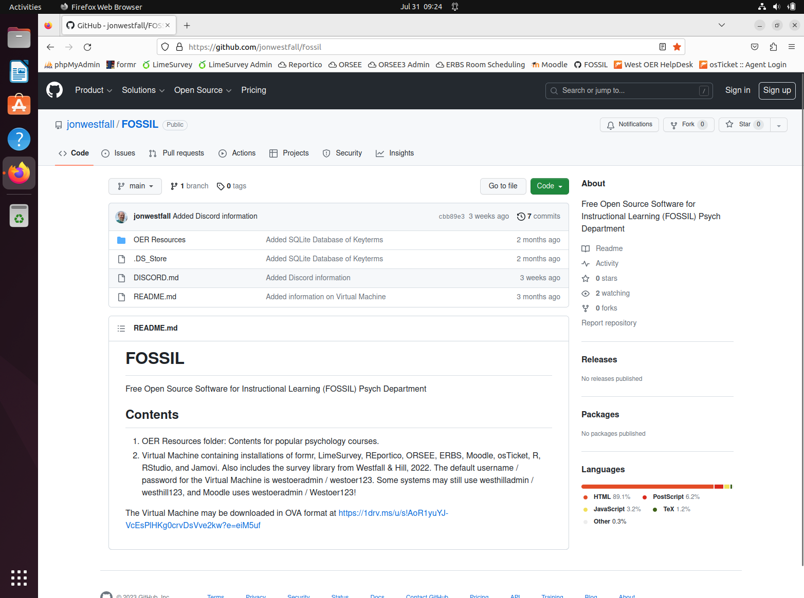
GitHub Repository & Virtual Machines
https://go.jonwestfall.com/fossil
One
Stop
Shop
Resources
Playground
Collaboration

Slide 28
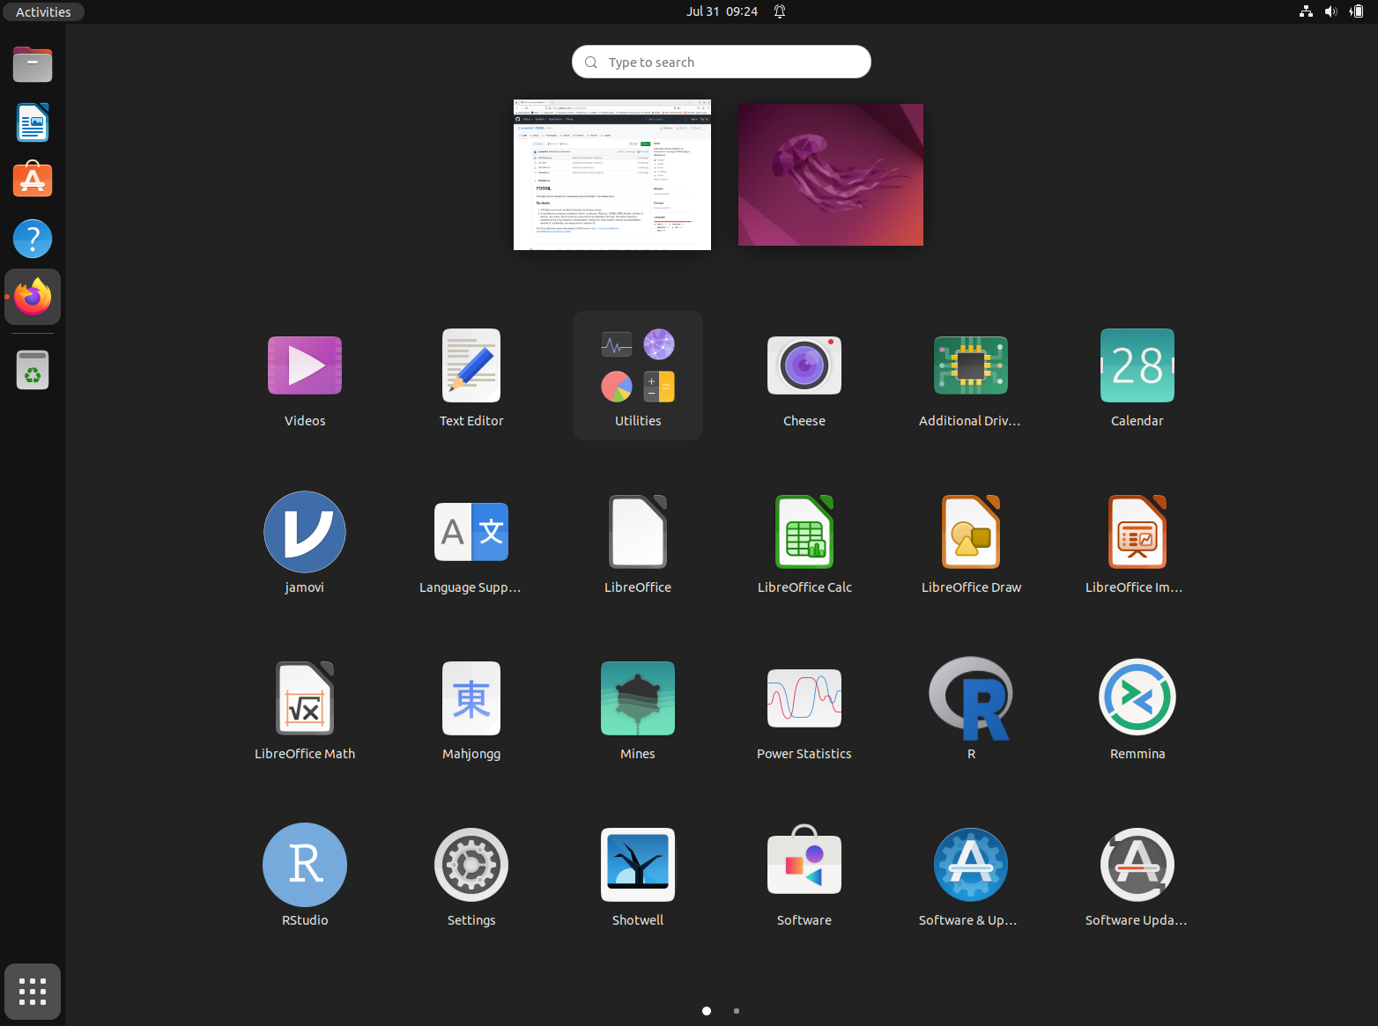
Virtual Machine Includes…
LimeSurvey
Survey Library of over a dozen pre-programmed measures.
formr
R
RStudio
Jamovi
Moodle
Reportico
ORSEE
ERBS Room Scheduler
osTicket

Slide 29
Provide Community
A community to discuss and collaborate!

Slide 30
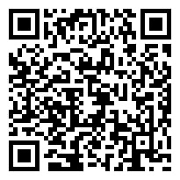
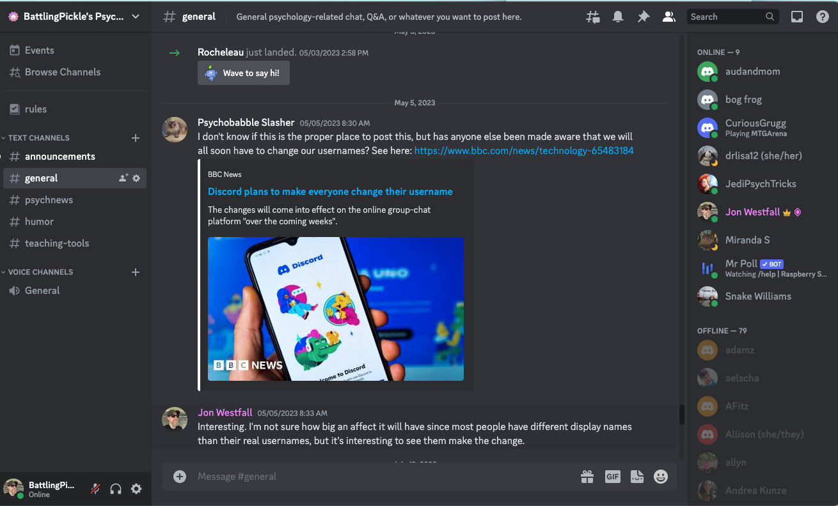
Join Our Discord (Let's Communicate!)
https://go.jonwestfall.com/psychout

Slide 31
Apply for Funding (Let’s Collaborate!)
Open Textbook Pilot Program (Dept. of Ed)
Pathways to Enable Open-Source Ecosystems (NSF)POSE)

Slide 32
Resources to Reference
Butcher, N. (2015). Basic guide to open educational resources (OER).
Camilleri, A. F., Ehlers, U. D., & Pawlowski, J. (2014). State of the art review of quality issues related to open educational resources (OER). Luxembourg: Publications Office of the European Union.

